Slide 1

Internal Project Abstract Review
Effect of Thermo-Mechanical Treatment in Austenitic Condition on Flow Behaviour of Reduced Activation Ferritic-Martensitic Steel
NAME OF THE PROJECT GUIDE
Mr.G.KULADEEP
Asst. Professor
Names of the Project Batch students
S. Pavan kalyan Reddy 19121A03D2
P. Siva Teja 20125A0333
K. Muni Sai Kumar Reddy 20125A0327
D. Reddy Sekhar 20125A0324
SK. Mohammad Waseem 19121A03C9
Date : 02-05-2023

Slide 2
Outline of the presentation
Introduction & background
Problem definition
Aim/Objective of the present study
Methodology
Literature review
Experimental work
Results and discussion
Conclusions
References

Slide 3
Introduction
Reduced Activation Ferritic - Martensitic steels:
are considered as structural material for plasma-facing blanket module of fusion reactor.
In radioactive environment, it is necessary to use low activation steels which when irradiated do not become radioactive or if activated, the radioactivity decays quickly.

Slide 4
Background
RAFM steel
Used for Test Blanket Module (TBM) to be tested at ITER
Used in normalized and tempered condition
Possess tempered martensite structure consisting of laths, blocks, and packets inside the prior-austenite grain.
The lath, block, and packet contain
high density of transformation induced dislocations,
Cr-rich M₂₃C₆ carbides - decorated along the boundaries and
Fine intragranular MX type precipitates, (M=V, Ta) (X=C, N)
Schematic illustration of tempered martensitic microstructure of 9-12%Cr steels
( Ref.: F. Abe et al, 2007)

Slide 5
Drawback with this microstructure …..
At elevated temperature
Coarsening of M₂₃C₆ carbides and MX carbonitrides occurs
On thermal ageing &
Creep exposure
The coarsening rate of M₂₃C₆ carbides is much faster than the MX carbonitrides.
These coarser M₂₃C₆ carbides along the PAG promote faster inhomogeneous microstructural recovery in the vicinity of grain boundary.
Thus, resulting in
Decrease in creep resistance
Early onset of tertiary stage of creep deformation and
Reduce creep rupture life.

Slide 6
Aim
To study the effect of thermomechanical treatment on microstructural stability, tensile, flow behaviour of RAFM steel.
Objectives
To carry out TMT of RAFM steel.
To carry out detailed microstructural evaluation by optical microscopy, SEM.
To evaluate the hardness, tensile (room temp & elevated temp) properties.
To compare the results of normalized and tempered steel with those obtained on thermomechanical treated steel.

Slide 7
Literature survey
Various literatures are found on the family of ferritic steels and their developments are made based on
improvement in microstructural stability by varying the alloying
elements.
- compositional modifications
- solid solution strengthening
stabilizing the precipitates
applying various strengthening mechanisms
by varying the heat treatment cycles
Thermo mechanical treatment

Slide 8
Methodology
(
Literature Review
Material Selection-RAFM steel
Fabrication of tensile specimens
Testing
Results Analysis

Slide 9
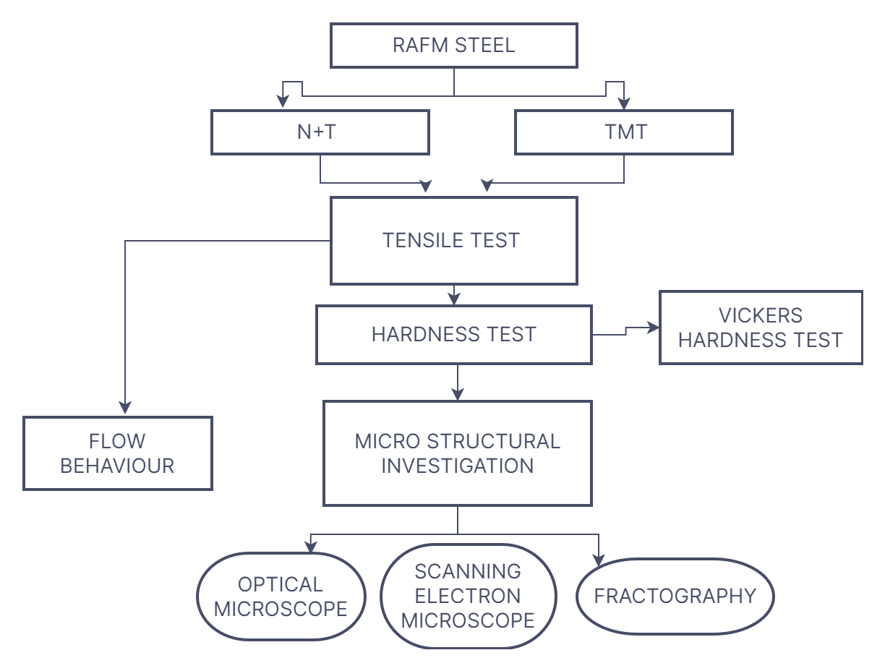
Problem Formulation :

Slide 10
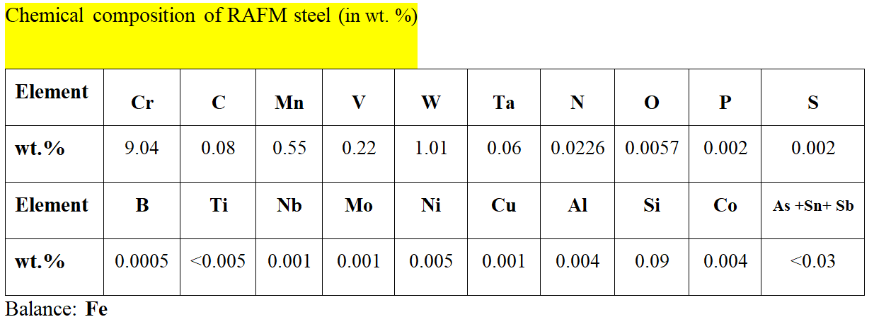
Material
(

Slide 11
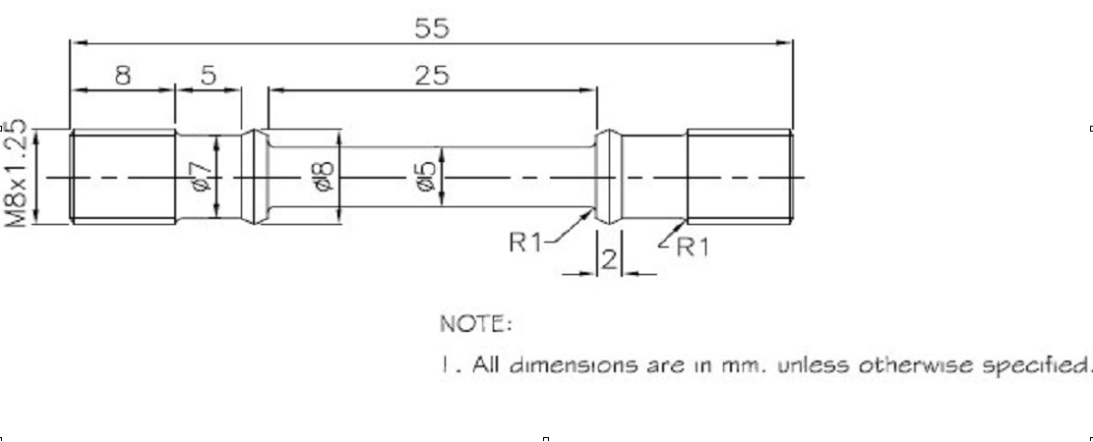
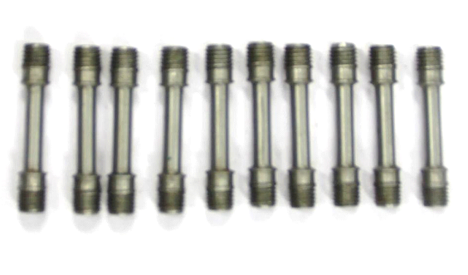
Schematic of standard tensile test
specimen (as per ASTM E8M)

Slide 12
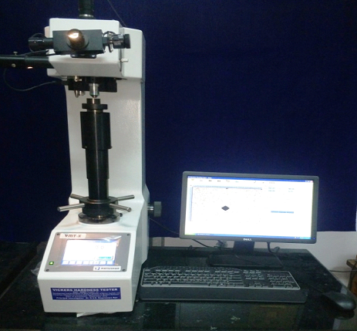
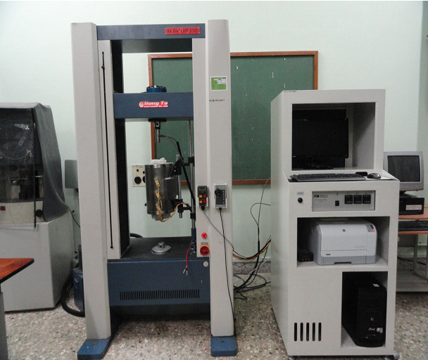
Vickers Hardness Tester
Tensile Test setup

Slide 13
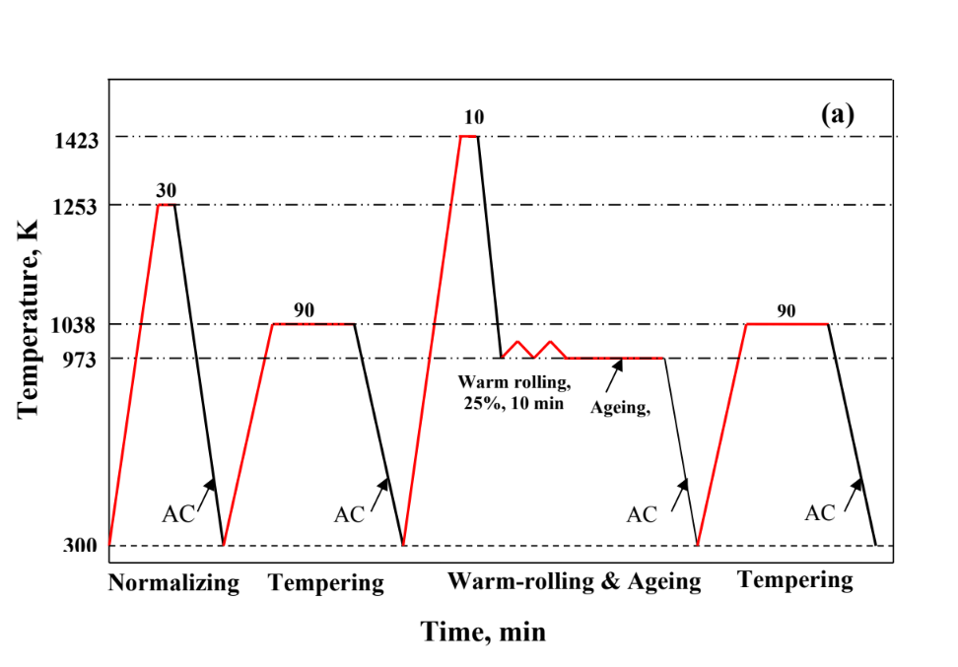
Experimental Investigations
Normalizing and tempering followed by thermomechanical treatment cycle used for RAFM steel in austenitic phase field

Slide 14
Tensile tests
Tensile tests were carried out on RAFM steel in N+T and TMT25 conditions using Hung-Ta tensile testing machine (model: HT-2402, capacity: 10 ton) in the temperature range of 300 - 923 K
The tensile testing machine is equipped with a 3-zone resistance heating furnace and digital data acquisition system.

Slide 15
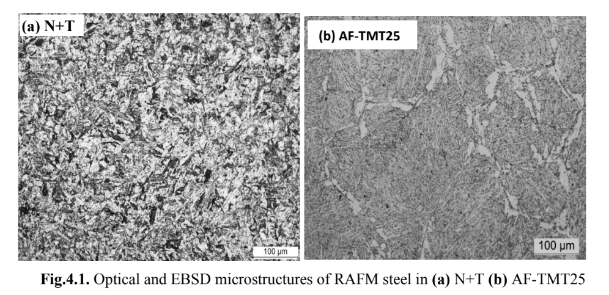
Experimental Results
Microstructure:
1. Optical and electron back scattered diffraction (EBSD) microstructures of RAFM steel in N+T, AF-TMT25 conditions:

Slide 16
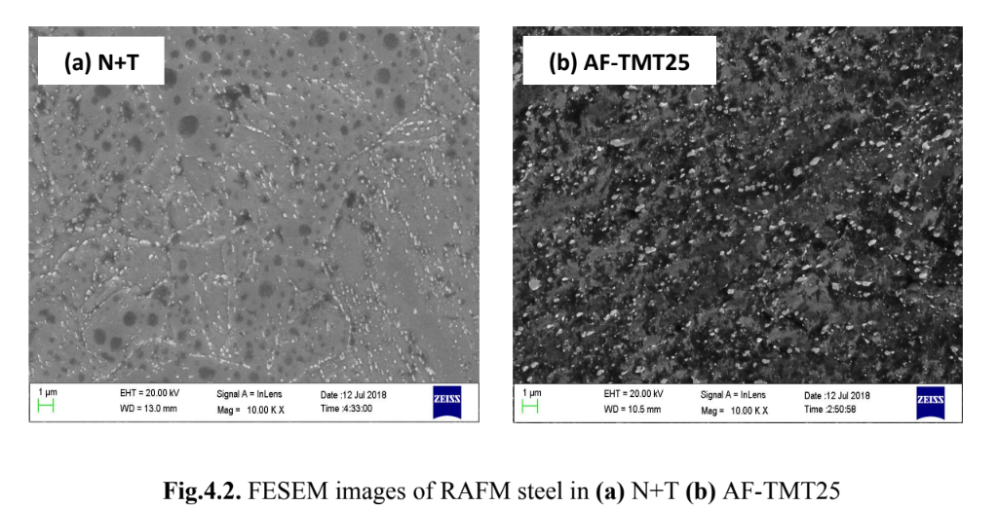
Scanning Electron Microscope (SEM)

Slide 17
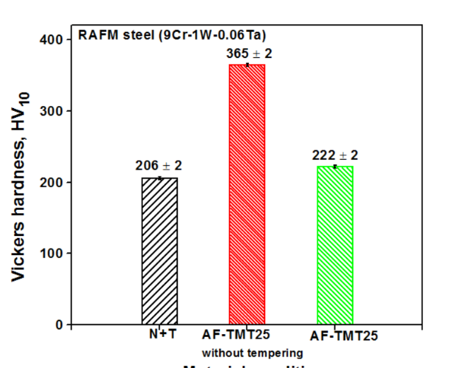
HARDNESS BEHAVIOUR
Effect of TMT in ferritic phase field on hardness

Slide 18
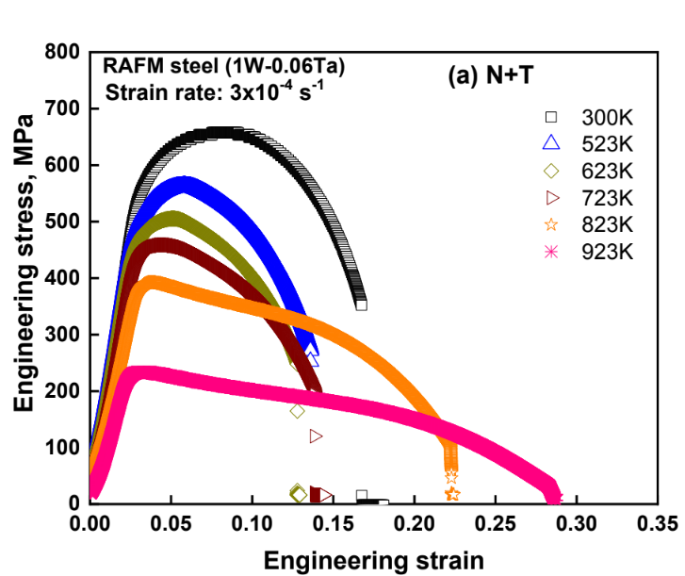
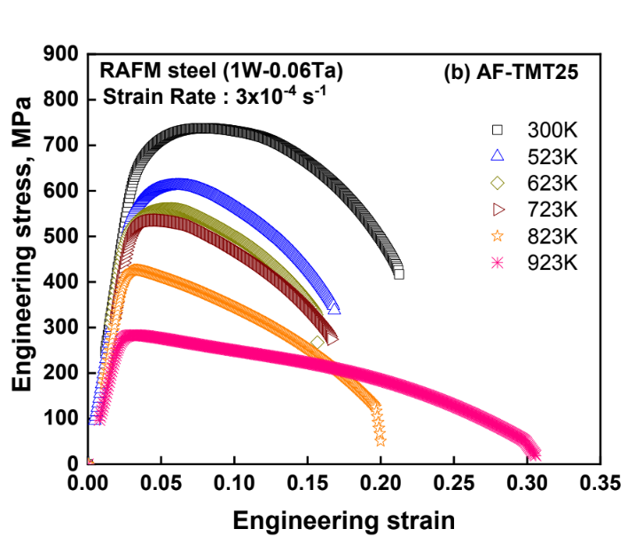
TENSILE BEHAVIOUR

Slide 19
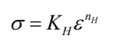
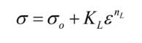
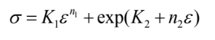
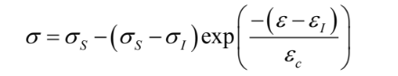
Constitutive flow behaviour:
a) Constitutive equation proposed by Hollomon
b) Constitutive equation proposed by Ludwik
c) Constitutive equation proposed by Ludwigson
d) Constitutive equation proposed by Voce

Slide 20
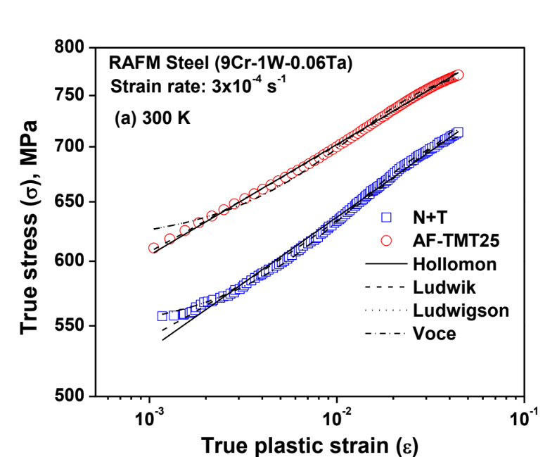
Constitutive flow behaviour:

Slide 21
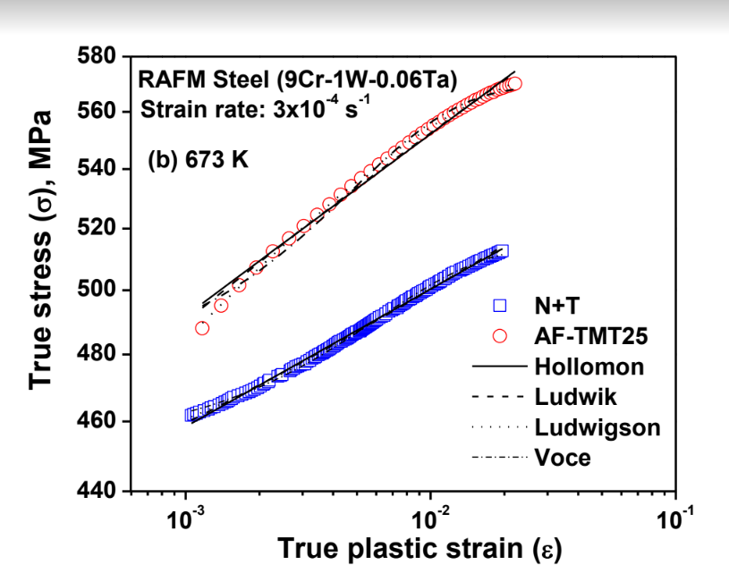
Constitutive flow behaviour:

Slide 22
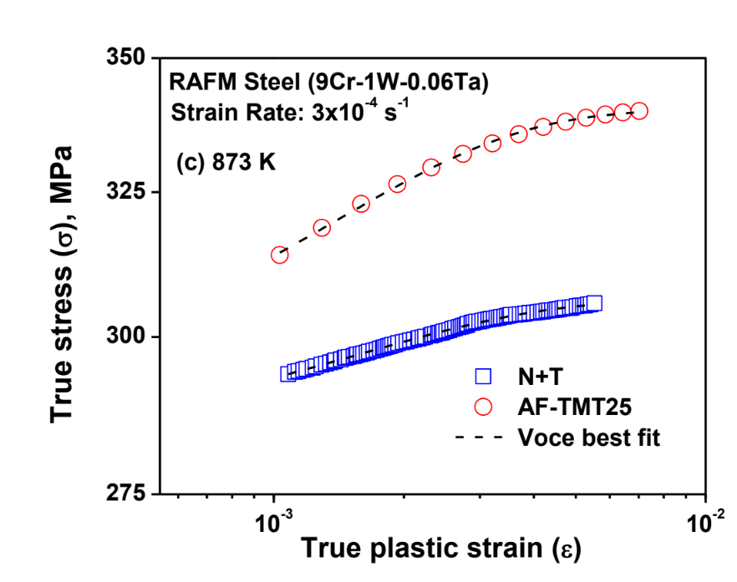
Constitutive flow behaviour:

Slide 23
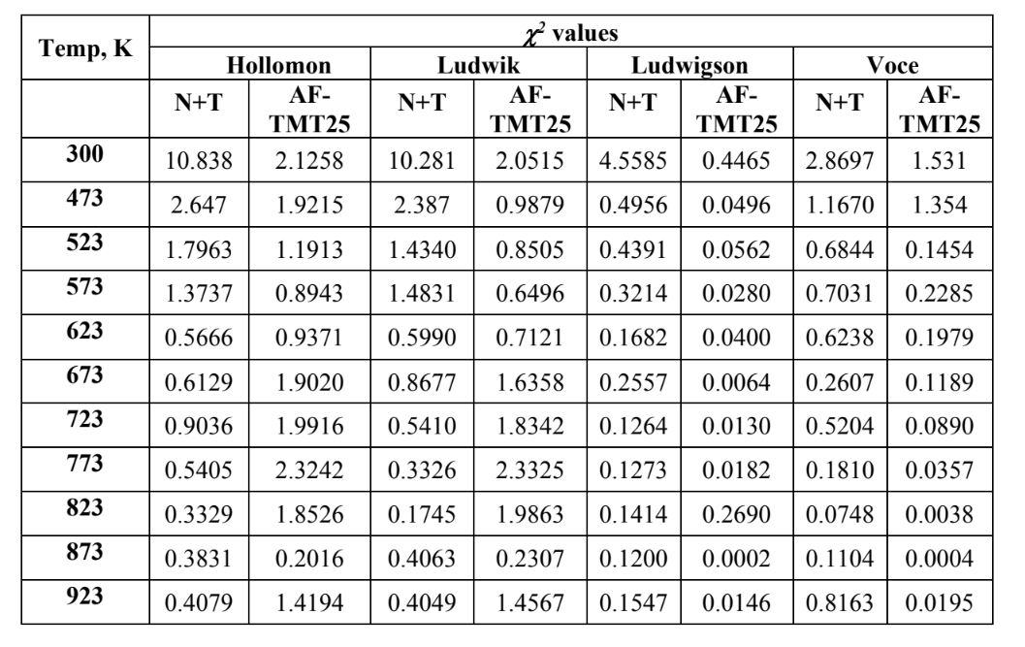

Slide 24
CONCLUSIONS
TMT of the steel refined the microstructure of the tempered martensite having finer lath size with substantial fine precipitates.
• TMT of the steel increased the hardness and tensile strength coupled with increase in ductility and work-hardening rate.
• The tensile flow behaviour of the RAFM steel in all three conditions was adequately described by Voce’s equation.
• TMT enhanced the tensile strength properties of RAFM steel without loss of ductility and is attributed to the refinement in microstructural features (lath width, precipitate size and distribution) of RAFM steel upon TMT.
• The steel in AF-TMT25 condition exhibited higher YS and UTS than the steel in the remaining two conditions. However, the YS and UTS of steel in FF-TMT25 condition are marginally higher than the steel in N+T condition.

Slide 25
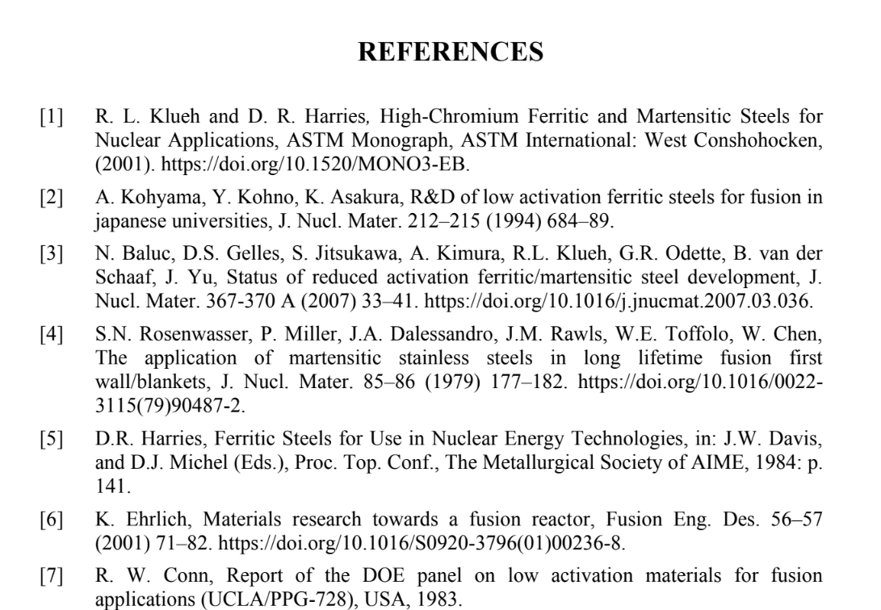

Slide 26
THANK YOU

